Slide 1
Chapter 8
Sequence Control
abhijit.comp@coep.ac.in

Slide 2
Sequence Control
Control order of execution of the operations
  Generate machine code that reflects the intended sequence of operations in HLL
Two types of sequences
  Implicit: Language defined
    Sequential execution of statements, While / for loop; if then else ,Expression evaluation
  Explicit: Programmer specified
    goto x; Using paranthsis

Slide 3
Sequence Control
Generating Code to take care of various sequencing issues
Expressions
  Order of evaluation of operators, etc
Statements
  If then else, for , while, assignment: Non-sequential jumps in the code
Functions/Subroutines
  Local variables, LIFO sequence,
Declarative programming: Prolog (case study)

Slide 4
Sequencing With Arithmetic Expressions

Slide 5
Root of an equation
R = (-b +- (sqrt(b*b-4*a*c))/(2*a)
  May generate upto 15 machine instructions
    Demo
  Normally machine instructions work on registers
  Need to move each variable into register
  Need temporary storage to store intermediate results
Order of evaluation
  Precedence
  Associativity

Slide 6
Syntax for expressions
Expression trees
  Seen before
Prefix Notation
  Functions f (a,b,c) → Prefix !
  ++i
  / + _ b # - ^ 2 x x 4 a c x 2 a
  Also called Polish Notation, after Lukasiewicz
Cambridge Prefix/Polish – Used in LISP
  Use parenthesis
  ( / ( + ( _ b) ( # ( - (^ b 2 ) ( x ( x 4 a) c)))) (x 2 a)

Slide 7
Syntax for Expressions
Postfix Notation
  i++
Infix notation
  Conventional mathematics notation, hence languages adopted it
  Suitable only for binary operations
    What does a + b * c mean ?

Slide 8
Code generation for expressions
Prefix algorithm
  If operator, push on stack. Set argcnt_desired.
  If operand, push on stack. argcnt_desired--
  If argcnt_desired == 0, pop operand and operators and evaluate
Postfix algorithm
  If operand, push on stack
  If operator, pop arguments, evaluate and push result

Slide 9
Code Generation for Expressions
Prefix and Postfix more easy to evaluate than infix. Postfix easiest
So may compilers convert the expression to postfix first
  Use system stack to store operands
  Code generation exactly like the algorithm

Slide 10
Precedence and Associativity
Precedence
  Operators with higher precedence evaluated first
  Study the C precedence rules
Associativity
  Same precedence, then which order ?
  Normally left-to-right
  Exceptions may exist: exponentiation a ^ b ^c = (a^{b})^{c} OR a^{(bc)}

Slide 11
Precedence Rules in Langauges
Pascal – sometimes weird
  a = b | c = d (C Equivalent is a == b || c == d )
  = is comparison
  Translates into a= (b | c) = d
  Invalid
APL
  Everything left to right
Forth
  1960s language. Memory expensive
  Postfix notation – so no precedence rules !

Slide 12
Generating code for expressions
Run time representation
  Machine code sequences
    C compiler does this
    Typically done by compiled languages
  Tree Structure
    Interpreted languages → interpreter creates a runtime tree and evaluates it
  Prefix or postfix form
    Interpreter converts the expression into infix/postfix and evalutes

Slide 13
Problems of order of evaluation
Uniform evaluation rules
Side effects
Error conditions
Short Circuit boolean expressions

Slide 14
Uniform Evaluation rules
In which order the operands should be evaluated ?
  fetch if a simple operand
  Compute if a complex operand like f(), or conditional
  Same operand may appear multiple times in the expression

Slide 15
Uniform evaluation rules
Eager evaluation rule: Evaluate operands first and then apply the operation.
  Order of evaluation of operands can be ANYTHING.
  So that compiler can optimize code. Demo.

Slide 16
Uniform evaluation rules
Consider: (a + b) * (c -a ). Suppose the m/c instructions can operate on only two operands at a time
Evaluation 1
  Fetch r-value of a
  Fetch r-value of b
  Add a and b, obtain d (“temporary)
  Fetch the r-value of c
  Substract a from c, obtain e (“temporary”)
  Multiply d and e, obtain result

Slide 17
Uniform evaluation rules
Consider: (a + b) * (c -a )
Evaluation 2:
  Fetch r-value of c
  Fetch r-value of b
  Fetch r-value of a
  Subtract a from c, obtain e (“temporary”)
  Add a and b, obtain d (“temp”)
  Multiply d and e, obtain result
Both approaches will give same result in this case, both require two temp memory locations

Slide 18
Uniform evaluation rules
Consider: Z + ( Y = 0 ? X: X /Y )
  If y zero then add x else add x/y to z
Eager evaluation (a uniform evaluation rule) will not work.
  Evaluate X , X/Y before applying the = operation (evaluate operands first) → So will cause run time error
Hence we can apply another Uniform evaluation rule → lazy evaluation

Slide 19
Uniform evaluation: Lazy Evaluation
Delay the evaluation of operands. Let the code for operator decide whether to evaluate.
Very impractical – inefficient
  Need to generate code to decide whether to evaluate or not
  c = a + b
    Read a , read b, decide whether to evaluate a+ b, then evaluate and store in c
Eager evaluation
  May not work in some cases
Lazy Evaluation
  Slow code

Slide 20
Side Effects
int a = 1;
int fun() {
a = 2;
Return 3
}
b = a * fun() + a
What is the value of b ?
If evaluated in same sequence; 1 * 3 + 2 = 5
Evaluate a only once in begining: 1 * 3 + 1 = 4
Call fun() before evaluating a: 3 * 2 + 2 = 8

Slide 21
Two views on side effects
Disallow them
  Language rules should prohibit OR
  Say that the result is “undefined”
Allow them
  Fix an order of evaluation
    Kill s optimization potential

Slide 22
Short Circuit boolean expression
If ((A == 0) || ( B /A > C)) { … }
While (( I <= 10) && (A[i] < C )) { .... }
If first condition is true/false then second may result in an error
Need conditional evaluation of second expression
  Called short circuit evaluation
  C does it !
What to do when we require to evaluate both ?
  Ada: or / or else keywords
  If (A ==0) or else (B / A > C ) then …

Slide 23
Error conditions
One operand evaluation may result in error
The error may depend on order of evaluation
A = B * C / D
C / D may result in underflow, but if B * C is done first, then there may not be an underflow
Solution: Let the programmer specify
  Disadvantage: Optimization may not be possible.

Slide 24
`
Sequence Control STATEMENTS

Slide 25
Assignment Statement
Different Syntaxes
  A := B Pascal, Ada
  A = B C, FORTRAN, PL/I, Prolog, ML, SNOBOL4
  MOVE B TO A COBOL
  A ← B APL
  (SETQ A B) LISP
C has multiple ways to assign: A=B, A++, ...
  How many C assignment operations can you identify?
Assignment through IO
  $x=<FILE> PERL – reads a line from file into variable x

Slide 26
Statement Level sequence Control
Composition
  Execute a group of statements one after another
  Sequential execution
Alteration
  Choose one of the paths
  If – then – else, case/switch
Iteration
  Repeat Zero or more times
  For, while, do while, ..

Slide 27
Explicit Sequence Control
Early languages used labels on statements and explicitly determined location of branches (early FORTRAN):
  IF (A.GT.7) GOTO 100
  ...
  100 CONTINUE Explicit control
“goto” controversy of the early 1970s.
  Languages do not need explicit control and concept is not used or needed even if present.
C includes a break statement for exit out of a loop and a continue statement
  It is a limited form of goto

Slide 28
Code Generation for Sequence Control
Composition
  Easy. One after Another.
Alteration
  If condition statement1 else statement2
  If condition then statement1 else statement2 endif
  If condition then statement1
    elsif condition2 then statement3
    elsif condition3 then statement3
  endif
  Code generation Demo.
  Switch/Case : Extended form of if then else . Demo.

Slide 29
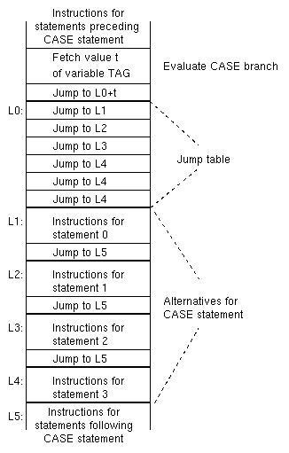

Slide 30
Iteration statements
Perform <body> K times
While <test> do <body>
For <var>:=<value> step <no> until <limit> do <body>
  for i:=2 step 2 until 30 do j=j+5;
  For k=n-1 step 2*(w-1) until m*n do <body>
foreach $x <list> { … }
Loop
  Exit when <condition>
End loop
C: for(expr1; expr2; expr3) { body } → Most powerful for loop
Code Generation Demo.

Slide 31
Some variations of iteration
Multiple exit loops
  For I = 1 to k do
    If <condition> then goto <label>
    <label is outside the loop
    Similar to break in C
Do while do : Not available in any language. Can be simulated using if (condition) break in C;
  Dowhiledo
    read(X)
    while(<condition>)
    process(x)
    End dowhiledo
Exception Conditions
  While <condition> { Code 1
    If <bad> goto x; Code 2 // raise X;
    }
    X: handle error

Slide 32
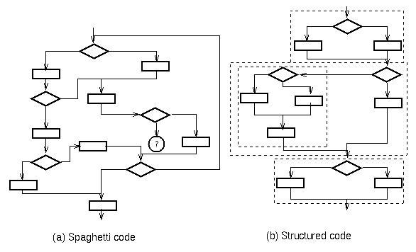
Structured Programming

Slide 33
Structured Programming
In short: no gotos !
Hierarchical program structure
  Correctness more imp than efficiency
  Program composed of groups of statements – each group is a conceptual unit of computation
  Each group organized using: composition, alteration or iteration only
Order of statements = order of execution
Single purpose groups of statements even if need to be copied

Slide 34
Theory for structured programs
Roy Maddux in 1975 developed the concept of a prime program
  Do we have the right control structures?
  Is a program structured ?

Slide 35
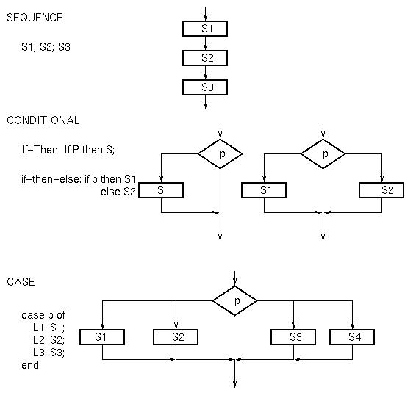
Control structures as Flow charts

Slide 36
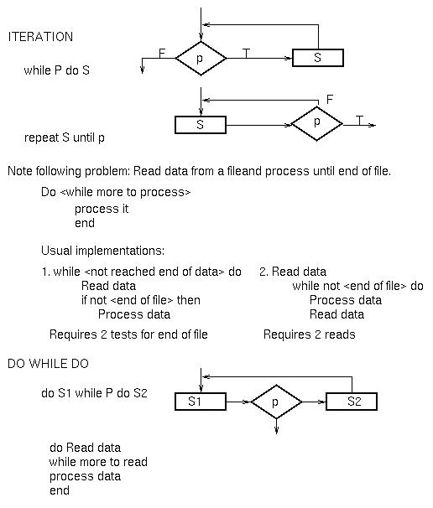
Control structures as Flow charts

Slide 37
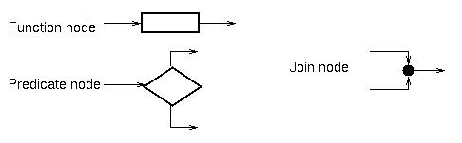
Prime Programs
3 types of flow chart nodes

Slide 38
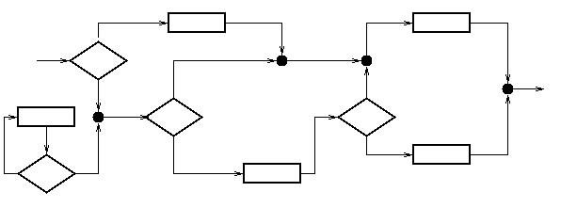
A Program
Program = Arcs + combinations of nodes
  Giving a graph

Slide 39
Proper Program
A proper program is a flowchart with:
  1 entry arc
  1 exit arc
  There is a path from entry arc to any node to exit arc
A prime program
  is a proper program which has no embedded proper subprogram of greater than 1 node. (i.e., cannot cut 2 arcs to extract a prime subprogram within it).
A composite program
  is a proper program that is not prime.

Slide 40
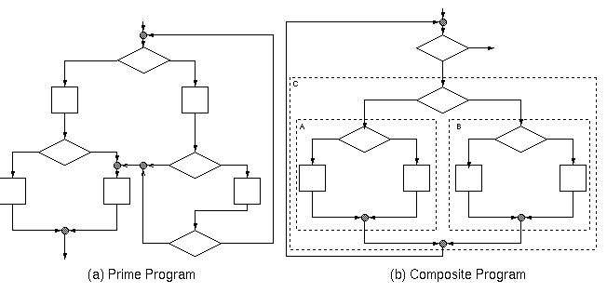
Prime and Composite program

Slide 41
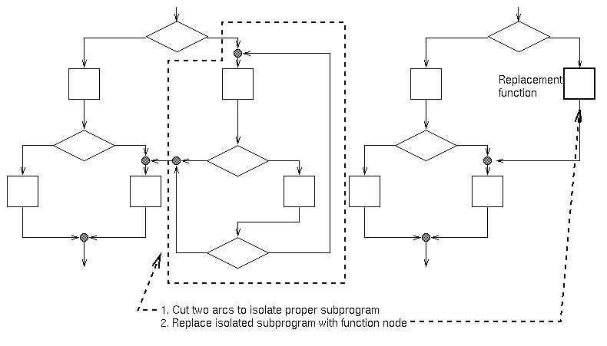
Prime Decomposition
Every proper program can be decomposed into a hierarchical set of prime subprograms. This decomposition is unique (except for special case of linear sequences of function nodes).

Slide 42
All prime programs can be enumerated
All primes can be enumerated (next slide)
Each implements a function.

Slide 43
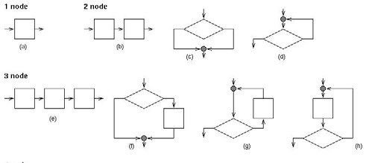

Slide 44
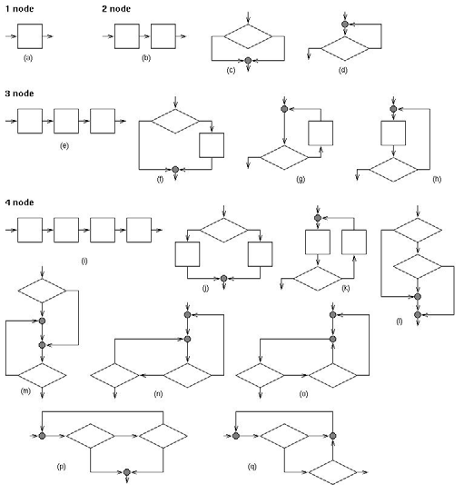

Slide 45
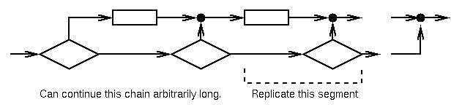
Number of primes is infinite
Use of prime programs to define structured programming: Concept first used by Dijkstra in 1968 as gotoless programming.
Called structured programming in early 1970s- Program only with if, while and sequence control structures.

Slide 46
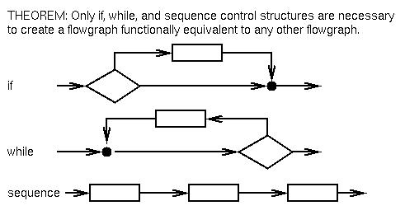
Structured Programming

Slide 47
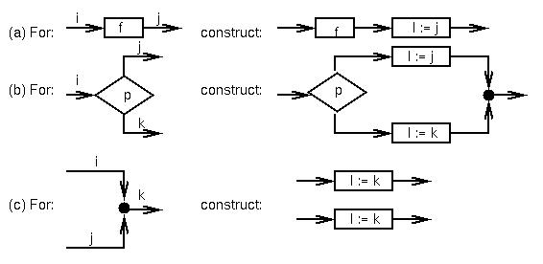
Structure Theorem
Outline of proof:
1. Label each arc with 1 being the entry arc and 0 the exit arc.
2. Let I be a new variable not used in program.
3. For each node in program construct the following:

Slide 48
In practice,
Structured programs are written,
Not converted from unstructured programs

Slide 49
Modern Languages
Allow single entry, but multiple exists
  Break, continue, exceptions are ways of giving multiple exits
This is also sometimes called structured programming

